Slide 1
RX Java Observables and Subscribers
James.Fennell@lit.ie

Slide 2
Reactive Streams
What are reactive streams and how do they work
Reactive Streams – the concept
The Scope of Reactive Streams
The Reactive Streams API

Slide 3
The Observable
The Observable is a push-based, composable iterator
For a given Observable<T>, it pushes items (called emissions) of type T through a series of operators(processors) until it finally arrives at a final Observer, which consumes the items
An Observable works by calling onNext(), onCompleted(), and onError() in the Observer

Slide 4
The Observable
The Observer has three abstract methods that the Observable calls
onNext():
passes each item one at a time from the source Observable all the way to the Observer
onComplete():
A completion event for the Observer, indicating that no more onNext() calls will occur
onError():
This communicates an error up the chain to the Observer
the Observer typically defines how to handle it

Slide 5
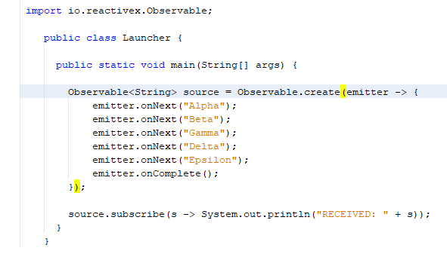
The Observable Using Observable.create()
A source Observable is where emissions originate from and is the starting point of our Observable chain
The Observable.create() factory creates an Observable by providing a lambda receiving an Observable emitter

Slide 6

The Observable Using Observable.create()
We can call the Observable emitter's onNext() method to pass emissions (one a time) up the chain
onComplete() signals completion and communicate that there will be no more items
The onNext() calls will pass items up the chain towards the Observer
The Observer will print each item

Slide 7
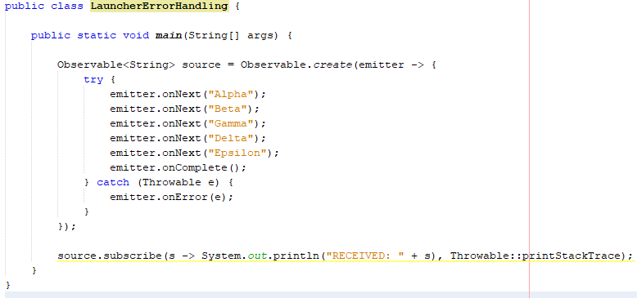
The Observable Using Observable.create()
We can catch errors that may occur within our Observable.create() block and emit them through onError()
The error is pushed up the chain and handled by the Observer
This particular Observer that we have set up can do that as shown

Slide 8
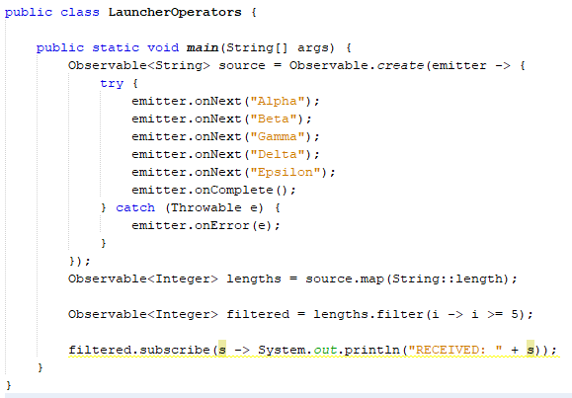

The Observable Using Observable.create()
As discussed onNext(), onComplete(), and onError() do not necessarily push directly to the final Observer
They can also push to an operator serving as the next step in the chain
Here we derive new Observables with the map() and filter() operators, which will act between the source Observable and final Observer printing the items

Slide 9
The Observable Using Observable.create()
With the map() and filter() operators between the source Observable and Observer, onNext() will hand each item to the map() operator
It will act as an intermediary Observer and convert each string to its length()
This, in turn, will call onNext() on filter() to pass that integer
The lambda condition i -> i >= 5 will suppress emissions that fail to be at least five characters in length
Finally, the filter() operator will call onNext() to hand each item to the final Observer where they will be printed.

Slide 10
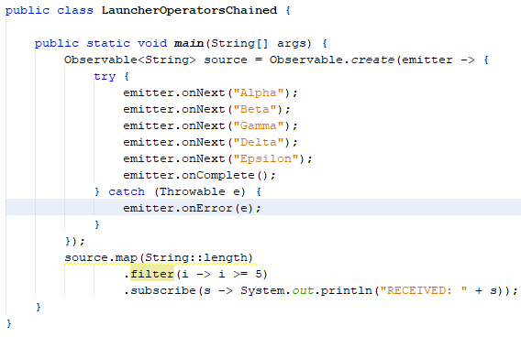
The Observable Using Observable.create()
The map() operator will yield a new Observable<Integer> derived off the original Observable<String>
The filter()will also return an Observable<Integer> but ignore emissions that fail to meet the criteria
Since operators such as map() and filter() yield new Observables we can chain all our returned Observables
Use the next operator rather than unnecessarily saving each one to an intermediary variable

Slide 11
The Observable Using Observable.just()
We probably will not need to use Observable.create() often
It is useful for sources that are not reactive
Typically, we use streamlined factories to create Observables for common sources

Slide 12
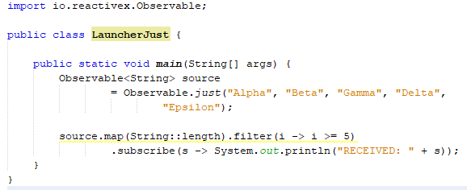
The Observable Using Observable.just()
We could have used Observable.just() to accomplish what we have just done
We can pass Observable.just() up to 10 items that we want to emit
It will invoke the onNext() call for each one and then invoke onComplete() when they all have been pushed

Slide 13
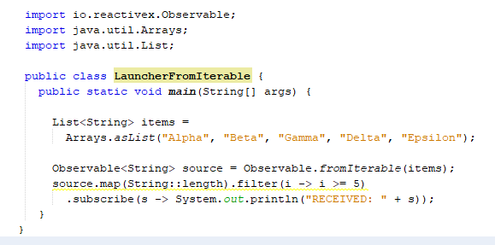
The Observable Using Observable.fromIterable()
We can also use Observable.fromIterable() to emit the items from any Iterable type, such as a List
It also will call onNext() for each element and then call onComplete() after the iteration is complete
This factory is used frequently since Iterables in Java are common and can easily be made reactive

Slide 14
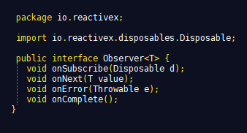
The Observer
The onSubscribe(), onNext(), onComplete(), and onError() methods define the Observer type, an abstract interface implemented throughout RxJava to communicate these events
We will focus on onNext(), onComplete(), and onError() first

Slide 15
The Observer
Observers and source Observables are somewhat relative
In one context, a source Observable is where your Observable chain starts and where emissions originate
In our previous examples, the Observable returned from our Observable.create() method or Observable.just() is the source Observable
To the filter() operator, the Observable returned from the map() operator is the source
It has no idea where the emissions are originating from
it just knows that it is receiving emissions from the operator immediately upstream from it

Slide 16
The Observer
Each Observable returned by an operator is an Observer that receives, transforms, and relays emissions to the next Observer downstream
It does not know whether the next Observer is another operator or the final Observer at the end of the chain
When we talk about the Observer, we are often talking about the final Observer at the end of the Observable chain that consumes the emissions
each operator, such as map() and filter(), also implements Observer internally

Slide 17
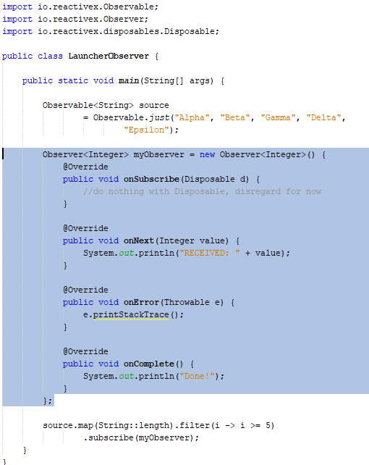
The Observer Implementing and subscribing to an Observer
When you call the subscribe() method on an Observable, an Observer is used to consume these three events (next, error, complete) by implementing its methods
Instead of specifying lambda arguments we can implement an Observer and pass an instance of it to the subscribe() method

Slide 18
The Observer Implementing and subscribing to an Observer
We quickly create an Observer<Integer> that serves as our Observer, and it will receive integer length emissions
Our Observer receives emissions at the end of an Observable chain and serves as the endpoint where the emissions are consumed
This means they reach the end of the process where they are written to a database, text file, a server response, displayed in a UI, or (in this case) just printed to the console

Slide 19
The Observer Implementing and subscribing to an Observer
We start with string emissions at our source
We declare our Observer in advance and pass it to the subscribe() method at the end of our Observable chain
each string is transformed to its length
The onNext() method receives each integer length emission and prints it using
System.out.println("RECEIVED: " + value)
If an error occurs anywhere in our Observable chain, it will be pushed to our onError() implementation on Observer
the stack trace of Throwable will be printed
Finally, when the source has no more emissions (after pushing "Epsilon"), it will call onComplete() up the chain all the way to the Observer, where its onComplete() method will be called and print Done! to the console

Slide 20
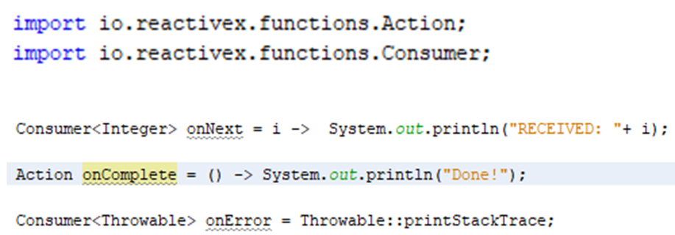
The Observer
Implementing an Observer for some use cases is too verbose and cumbersome
The subscribe() method is overloaded to accept lambda arguments for our three events
We will want to use this for most cases, and we can specify three lambda parameters separated by commas
the onNext lambda
the onError lambda
the onComplete lambda
For our previous example, we can consolidate our three method implementations using these three lambdas

Slide 21
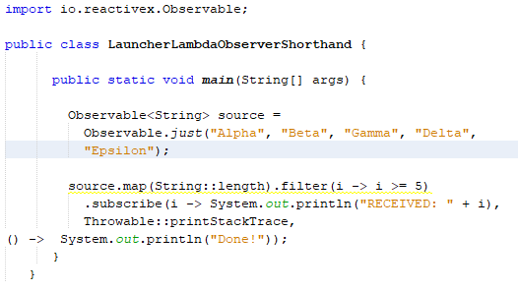
The Observer Shorthand Observers with lambdas
We can pass these three lambdas as arguments to the subscribe() method
It will use them to implement an Observer for us
This is much more concise and requires far less boilerplate code
There are other overloads for subscribe()
You can omit onComplete() and only implement onNext() and onError()
This will no longer perform any action for onComplete()
You can even omit onError and just specify onNext
Our first code snippet!

Slide 22
The Observer
Not implementing onError() is something you want to avoid doing in practice
Errors that happen anywhere in the Observable chain will be propagated to onError() to be handled and then terminate the Observable with no more emissions
If you do not specify an action for onError, the error will go unhandled
You can use retry() operators to attempt recovery and resubscribe to an Observable if an error occurs
We will cover that next week
Most of the subscribe() overload variants (including the shorthand lambda ones we just covered) return a Disposable that we did not do anything with
Disposables disconnect an Observable from an Observer so emissions are terminated early
critical for infinite or long-running Observables

Slide 23
Observables Cold versus Hot
There are subtle behaviours in a relationship between an Observable and an Observer depending on how the Observable is implemented
A major characteristic to be aware of is cold versus hot Observables
This defines how Observables behave when there are multiple Observers
First, we will cover cold Observables

Slide 24
Cold Observables
Cold Observables will replay the emissions to each Observer
Ensuring that all Observers get all the data
Cold Observables are much like a music CD that can be replayed to each listener
so each person can hear all the tracks at any time
Most data-driven Observables are cold
this includes the Observable.just() and Observable.fromIterable() factories

Slide 25
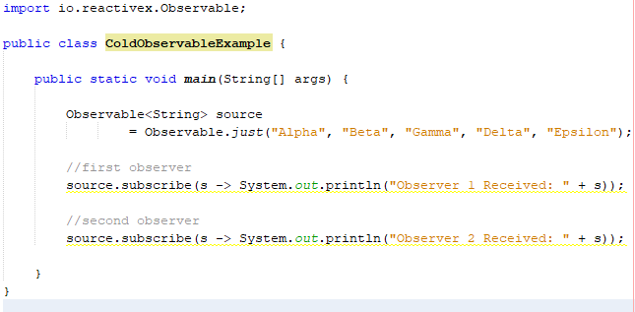
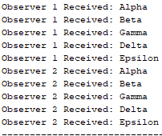
Cold Observables
In the example, we have two Observers subscribed to one Observable
The Observable will first play all the emissions to the first Observer and then call onComplete()
Then, it will play all the emissions again to the second Observer and call onComplete()
They both receive the same datasets by getting two separate streams each, which is typical behaviour for a cold Observable

Slide 26
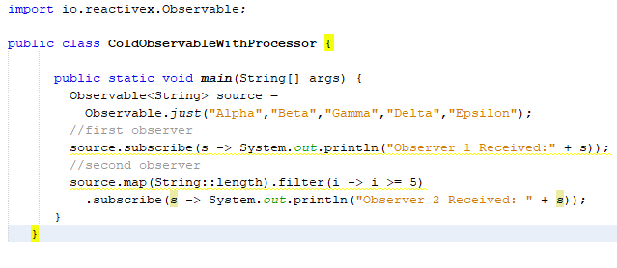
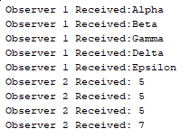
Cold Observables
If the second Observer transforms its emissions with operators it still gets its own stream of emissions
Using operators such as map() and filter() against a cold Observable still maintain the cold nature of the yielded Observables
Remember:
Observable sources that emit finite datasets are usually cold.

Slide 27
Hot Observables
A Hot Observable broadcasts the same emissions to all Observers at the same time
An Observer subscribes to a hot Observable and receives some emissions
If another Observer comes in afterwards, that second Observer will have missed those emissions
If a Cold Observable works like a music CD, Hot Observables are like a radio station
Just like a radio station, if you tune in too late, you will have missed that song.

Slide 28
Hot Observables
Hot Observables often represent events rather than finite datasets
The events can carry data with them, but there is a time-sensitive component where late observers can miss previously emitted data
For instance, a JavaFX or Android UI event can be represented as a hot Observable
In JavaFX, you can create an Observable<Boolean> off a selectedProperty() operator of a ToggleButton using Observable.create(). You can then transform the Boolean emissions into strings indicating whether the ToggleButton is UP or DOWN and then use an Observer to display them in Label, as shown in the following code snippet:

Slide 29
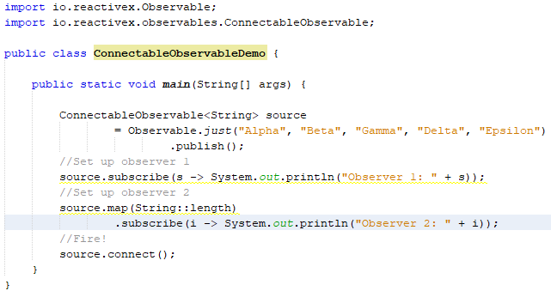
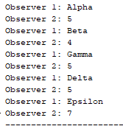
Connectable Observable
A ConnectableObservable will take any Observable, even if it is cold, and make it hot so that all emissions are played to all Observers at once
To do this conversion, you simply need to call publish() on any Observable
it will yield a ConnectableObservable
You need to call its connect() method to start firing the emissions
This allows you to set up all your Observers beforehand

Slide 30
Connectable Observable
One Observer is receiving the string while the other is receiving the length and the two are printing them in an interleaved fashion
Both subscriptions are set up beforehand, and then connect() is called to fire the emissions
Each emission goes to each Observer simultaneously
Observer 1 receives Alpha and Observer 2 receives 5 and then Beta and 4, and so on
Using ConnectableObservable to force each emission to go to all Observers simultaneously is known as multicasting
ConnectableObservable is helpful in preventing the replay of data to each Observer, use it when
replaying emissions is expensive and you would rather emit them to all Observers at once
you want to force the operators upstream to use a single stream instance even if there are multiple Observers downstream
Multiple Observers normally result in multiple stream instances upstream, but using publish() to return ConnectableObservable consolidates all the upstream operations before publish() into a single stream
Remember: ConnectableObservable is hot - if new subscriptions occur after connect() is called they will miss emissions that were fired previously

